Slide 1
ENPM 662
Navjyot Purohit (117801576)
Param Dave (117476323)
Robot Modelling Project 2 Leg Mechanism for Quadrupedal Robot

Slide 2
Introduction
Legged Robots have found their niche when it comes to applications that involve traversing uneven terrain.
In this project, we exploit the redundancies present in a leg mechanism that is overactuated.
The leg assembly composed of revolute joints has 6 dofs that allow it to generate complex gait cycles.
The rotations produced at the joints would be such that there is no pitching of the body.

Slide 3
Model Assumptions
1
2
3
The rotations of links are 2-Dimensional in the xy plane.
At least 2 legs stay in contact with the ground
The robot is dynamically stable while in motion.

Slide 4
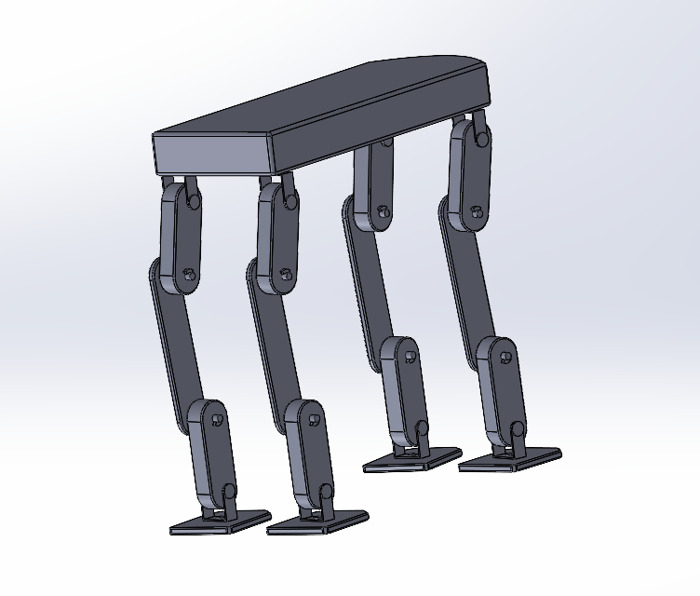
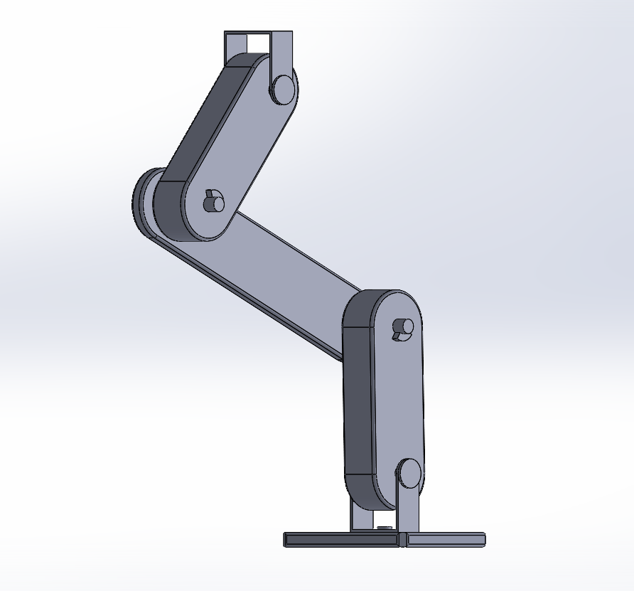
CAD Model

Slide 5
Robot Kinematics
Since the robot has excessive degrees of freedom, simply calculating the inverse of jacobian would not cut the deal.
We decided derive the desired set of joint trajectories geometrically and then combine these constraints in the jacobian matrix.
The joints are actuated such that there is no change in the ‘y’ co-ordinates..
The jacobian matrix that is constructed is 2x2 which saves time computationally.

Slide 6
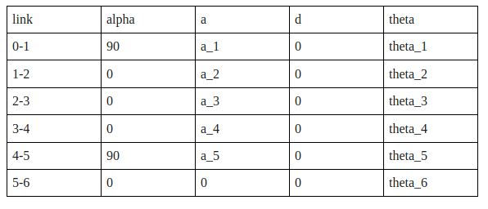
DH Parameters

Slide 7
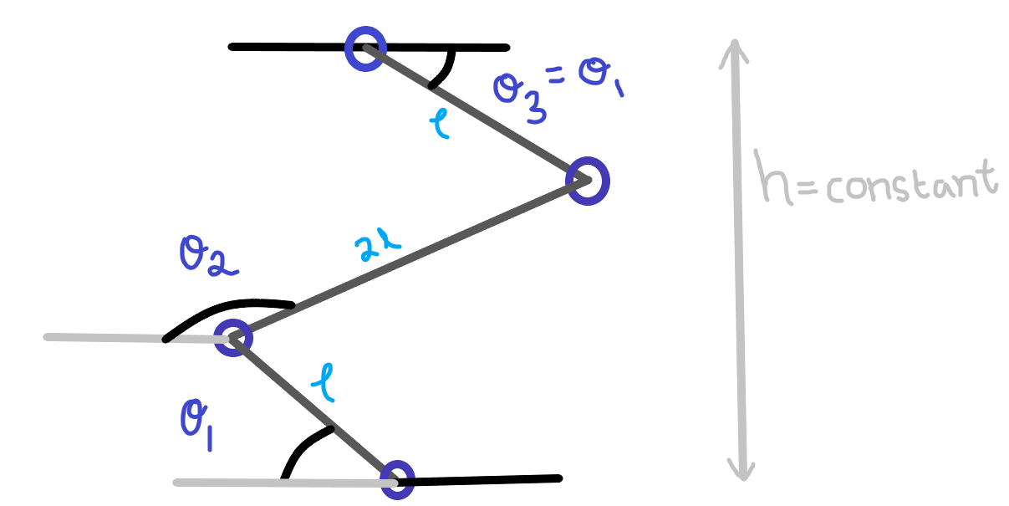
Trajectory Generation

Slide 8
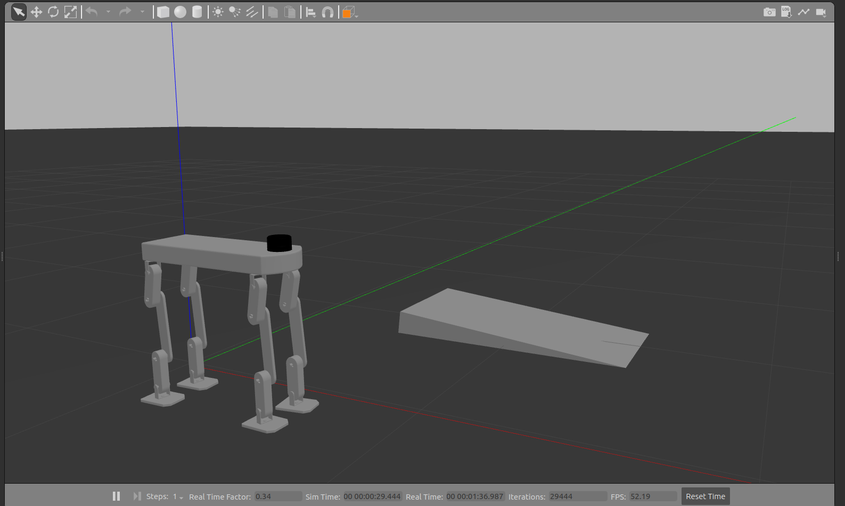
Simulation

Slide 9
Difficulties Faced
Solving the 6x6 jacobian matrix would not provide us with an optimum solution, hence we had to simplify the kinematics by adding geometric constraints.
The URDF exporter fails to recognize joint co-ordinate systems when multiple leg assmblies are imported.
The base of the robot and its foot have to avoid pitching during motion.
A trajectory had to be derived that prevents the robot from toppling.

Slide 10
Further Study
Deriving joint angle relations for different gait modes.
Solving the friction-cone problem to determine the optimum landing angle for the foot.
Maintaining dynamic balance during jumping or leaping motion.

Slide 11
Thank You!

